Slide 1
SoftApp FRP Application: shared-folder setup
REGULATORY AND STATUTORY REPORTING PROJECT · CAB BRIEF
Let users run the FRP application from their own workstations through a shared application folder, instead of one Remote Desktop session at a time.
Change ID
Requested by
ARB date
Proposed window
[CHG-______]
[Name, unit]
26 Sep 2025
[Date, time]
Notes:
Based on the As-Built Design (v1) and the ARB deck for the SoftApp FRP Application. Fill in the bracketed fields before the meeting.

Slide 2

A Windows application that prepares the bank’s BSP reports
WHAT IS THIS APPLICATION?
The SoftApp FRP Application is an on-premise Windows desktop application. It takes the bank’s source data, checks it against BSP’s rules, converts it into the XML BSP requires, and submits it.
1 · Import
2 · Validate
3 · Convert
4 · Submit
Source data from T24, GA and business units is loaded into input templates.
Checked against BSP’s XSD and validation rules, with Maker / Checker review.
Turned into BSP XML, with a working paper and a missing-report check.
Sent to BSP through the REST API; COCREE through the BRMS portal.
Reports covered include FRP Annex A and B (SOLO and CONSO), BRIS, CAR Basel III, LCR, NSFR, COCREE, CDRC, AFRD and ITRS.
SoftApp FRP Application · CAB brief
2
Notes:
From Project Details (modules: Validation, XML Conversion, XRM submission), System Interfaces, Reporting and Processes, and Fault Management in the As-Built Design. Users: MRRD (EWB UNI) and FRCT (EWB RB).

Slide 3
From one Remote Desktop user to many at once
01 · THE CHANGE
BEFORE (ARB DESIGN)
AFTER (AS-BUILT)
Run on the server through RDS
Run on the workstation from a shared folder
Users connect to the Application Server by Remote Desktop and run the application there. Several users can’t run it at the same time.
The application folder on the Application Server is shared with authorized users as a mapped drive. Each user runs the application from their own PC.
Benefit
Users
Unchanged
Several users work at the same time, with less dependence on Remote Desktop sessions.
MRRD (EWB UNI) and FRCT (EWB RB), on bank laptops and PCs.
Servers, database, reports, and the submission path to BSP.
SoftApp FRP Application · CAB brief
3
Notes:
This is the deviation recorded in the As-Built Design’s Change/Deviation Summary (System Interfaces).

Slide 4
What the application does and why the bank needs it
02 · PROJECT CONTEXT
Item | Detail
Modules | Validation, XML Conversion, and XRM (submission to BSP). Phase 2 adds an ETL feed from core banking into a staging database.
Compliance driver | Section 172 of the MORB (December 2022); Memorandum Nos. M-2023-004 and M-2021-052.
Business units | MRRD (EWB UNI) and FRCT (EWB RB). Contributors: Process and System Support, ITG.
Solution | SoftApp, chosen over FPTI (NOAH) and G2 Risk Solutions (FinTellix). On-premise; no web version is available.
Timeline | Start 2 Oct 2025 (tentative). Phase 1 target 6 Jul 2026; Phase 2 to be decided.
Risk if not done | The team keeps its manual process, which is slow, error-prone, and exposed to MORB resubmission penalties.
SoftApp FRP Application · CAB brief
4
Notes:
Taken from Project Details and Design Considerations in the As-Built Design. The POCs, led by MRRD, concluded in February and August 2025.

Slide 5
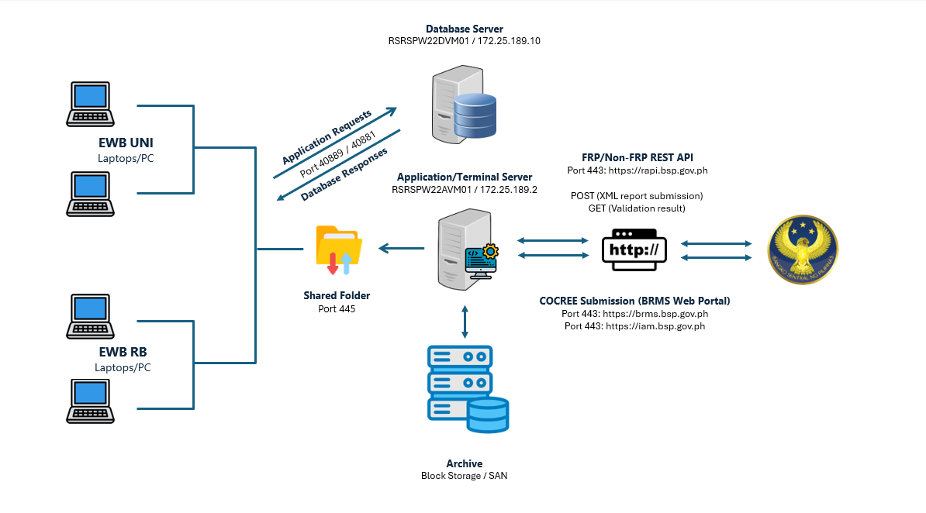
Network and access
03 · AS-BUILT SETUP
Shared folder
On Application Server RSRSPW22AVM01 (172.25.189.2), TCP 445
Database
RSRSPW22DVM01 (172.25.189.10), SQL Server 2022, ports 40889 / 40881
BSP
rapi.bsp.gov.ph, brms.bsp.gov.ph and iam.bsp.gov.ph, all HTTPS 443
Archive
Block storage / SAN, 2 TB
SoftApp FRP Application · CAB brief
5
Notes:
Diagram from the As-Built Design, Network and Remote Access. Both servers run Windows Server 2022; the application needs .NET Framework 4.8 or higher and Microsoft 365 (64-bit).

Slide 6



Who can reach the shared folder, and how
04 · SHARED-FOLDER CONTROLS
Network
Approved users
Permissions
Reachable only on the bank LAN or VPN. IP whitelisting and port opening for TCP 445 and the database ports.
Only approved users can open the shared folder. Each user signs in with a unique account (LDAP / AD).
Read & Execute only on the application folder. Users have restricted, non-admin workstation accounts.
Database access from the workstation
The application running on the user’s PC connects with the FRP service account. Its password is managed by DCD and SysAd, each holding one half (left and right password). The configuration file is encrypted.
SoftApp FRP Application · CAB brief
6
Notes:
From the Security Controls box on the As-Built System Interfaces diagram, plus the client-side items of the Security table.

Slide 7
Controls from the workstation to BSP
05 · SECURITY
Client PC connection | Application and database servers | Submission to BSP
LDAP / AD integration | MBSS hardening | REST API URL whitelisting
Restricted (non-admin) account | Trellix ENS | Secured by BSP-issued certificate
IP whitelisting | ATP and FireEye | COCREE: Kleopatra encryption with BSP’s public key
Port opening | SIEM and network firewall | BRMS portal whitelisting
VAPT
Encryption
Access matrix
Rapid7, performed by ISDPO.
Configuration file encrypted; TLS 1.2 in transit.
Maker / Checker for Admin and Business tasks; trail reports for all.
SoftApp FRP Application · CAB brief
7
Notes:
Security table and User Access Matrix from the As-Built Design. Admin Makers manage user profiles and attributes; Checkers validate tasks. Business Makers import, map and process; Checkers validate and produce reports.

Slide 8
Server load stayed low with the shared folder
06 · CAPACITY
6%
14%
160 Kbps
CPU
Memory
Network
Application Server, Task Manager after the shared-folder setup
17 of 128 GB in use
Peak send on the Ethernet adapter
Simultaneous test (DEV, Aug 2026) | CPU max | Memory max | Network max
Application Server | 6.3% | 13.51% | 160 KB/s
Database Server | 3.08% | 15.14% | 106 KB/s
SoftApp FRP Application · CAB brief
8
Notes:
Highest values across Report Validation, Conversion to XML (UNI) and Conversion to XML (RB), measured with Site24x7 on 20 and 25 Aug 2026. Archive need: 1.4 TB over five years, including 20% resubmissions. Retention: five years.

Slide 9
Deployment steps
07 · IMPLEMENTATION
Prepare and harden the Application and Database Servers (MBSS).
Whitelist and open ports: workstations to the Application Server on TCP 445; workstations to the Database Server on 40889 / 40881; Application Server to BSP on 443.
Configure the FRP service account; DCD and SysAd each hold half of its password.
Deploy the database and the application to production.
Share the application folder and grant Read & Execute to the approved users’ AD group [group name].
Map the shared drive on MRRD and FRCT workstations [drive letter and path].
Smoke test with several users at once, then PIR and sanity testing by the business units.
Steps 5 and 6 are the shared-folder change; the other steps follow the deployment approach approved at ARB.
SoftApp FRP Application · CAB brief
9
Notes:
Based on Deployment Approach in Other Design Details: mapping, templates and validation rules, UAT, deployment scripts and documents, CAB, server preparation and hardening, firewall whitelisting, port opening, service account configuration, then database and application deployment.

Slide 10
Who tests what
08 · TESTING
Testing type | Responsible unit
Unit testing | SoftApp
Smoke testing | SoftApp
System testing (end to end) | SoftApp
User acceptance testing | EWB business units (MRRD, FRCT)
PIR and sanity testing | EWB business units
VAPT | EWB ITG (Rapid7, c/o ISDPO)
Already done for the shared folder
Simultaneous-use test in DEV (20 and 25 Aug 2026): Report Validation, Conversion to XML (UNI) and Conversion to XML (RB), with server load monitored in Site24x7. UAT status: [confirm].
SoftApp FRP Application · CAB brief
10
Notes:
Testing matrix from Other Design Details in the As-Built Design.

Slide 11



If something goes wrong
09 · FALLBACK AND SUPPORT
Rollback
Recovery
Incidents
Remove access to the share and unmap the drive. Users go back to the ARB setup: Remote Desktop to the Application Server.
Regular backups of files, the database and server images. The BIA rates the system low priority and non-critical; the manual process remains available.
Server, database or GA unreachable: file an SR ticket with IT. Expired BSP certificate: renewal by the BU, deployed through a CR ticket.
Level 1 | Level 2 | Level 3 | Level 4
Service Desk | Production Support; SRAU for access | GL Enterprise Team | SoftApp Team
SoftApp FRP Application · CAB brief
11
Notes:
Sources: Fault Management, Scalability, Resilience and Disaster Recovery, and Operational Requirements in the As-Built Design. DBA handles database maintenance and backup; System Administrators handle server maintenance and images; Network handles network issues.

Slide 12
CAB is asked to approve the shared-folder setup in production
10 · DECISION
Approve
Confirm before go-live
Share the application folder on RSRSPW22AVM01 (Read & Execute, approved users only)
Firewall rules: TCP 445 and 40889 / 40881 from MRRD and FRCT workstations
Deployment window: [date, time]
AD group and approved user list [names]
Where the application writes its working and output files, since the share is read-only
UAT sign-off [status]
Notes:
The second column lists items the As-Built Design does not state. Fill them in or remove them before the meeting.

